Slide 1


Senior Project Shortcomings and Wishlist
Summer 2016
Team Members: Eric Aguiar, Jorge Nonell, Alex Karpis, Christopher Naranjo
Product Owner: Dr. Francisco R. Ortega
Instructor: Masoud Sadjadi
School of Computing and Information Sciences
Florida International University
Notes:
Hello my Name is Eric Aguiar and our project is Multi Modal Interactive Paint.
In this video I will be going over the Shortcomings and Wishlist for this project.

Slide 2
Shortcomings
CPU intensive due to multiple devices
Performance improvements by threading
Multiple infrared devices continue to be a problem
Placing them appropriately is important because if the infrared of the devices overlap it could cause disruptions with reading user input.
Text is stretched to fit the location: should be uniform throughout
Kinect only works with a single user and has trouble distinguishing multiple people
Notes:
The painting application is CPU intensive due to multiple integrated devices
Performance improvements could be done by threading the devices
*** Show Slide with the different devices
Multiple devices use infrared technology which continue to be a problem
Because if the infrared of the leap motion device and the real sense camera overlap it could cause disruptions with reading user input
**Show similar demonstration by painting with the app
Text is stretched to fit the location in the device menu, so the text should be made uniform throughout the application
**Show similar demonstration by pointing out the text in the app
The Kinect drawing only works with a single user and has trouble distinguishing multiple people
**Show example by demonstrating the pictures
Currently the undo button in menu un-does the last shape created by the leap motion device but should also be made to undo the last shape created by the Multi Touch device
Currently the Layer Visualization Feature displays and toggles between the shapes created by the Leap Motion device but should also be made to display the shapes created by the Multi Touch
Currently when the application is resized the shapes of the Leap motion device stay on the canvas but the Multi touch shapes are erased. This should be made so the Multi Touch shapes are not erased.

Slide 3
Wishlist
Speech recognition
ColorWheel
Microsoft HoloLens integration
3D cameras to avoid conflicting infrared devices
Tutorial system to show how to use devices
Feature to indicate whether you are being read by the Real sense
Gamification
Notes:
Some examples of features we wish could be implemented in the future are
Speech recognition could also be implemented by using the Xbox Kinect device
A color wheel could be added to give users more color options instead of having to choose from the default colors
*** Show color dropdown as an example
Currently there are only three layers by default within the layer visualization feature which users can use to draw on and toggle between. A future feature could be to start off with one layer and
Allow users to add or remove up to six layers which could allow more flexibility to the user. However, keeping track of too many layers could be resource intensive so a limit should be set on how many layers they can create.
*** Show the Layer Visualization Feature currently
*** Show image of how the plus and delete buttons could be drawn
When a user resizes the application there is no way for the users to see the drawings on the other parts of the canvas. So a scroll bar could be implemented to allow the users to move around the canvas.
*** Draw scroll bars and show example of how drawings aren’t seen when the window is resized
- Currently a user cannot tell which feature of the Real Sense camera they are using. So some sort of user feedback should be given to let them know which feature is being activated.
Currently there is no simple way to learn how to use the various devices so having some sort of tutorial system to show the users how to use the different devices would be very beneficial
A gamification feature could also be implemented along with the tutorial to get users exited about achieving certain goals by using certain aspects of the devices

Slide 4
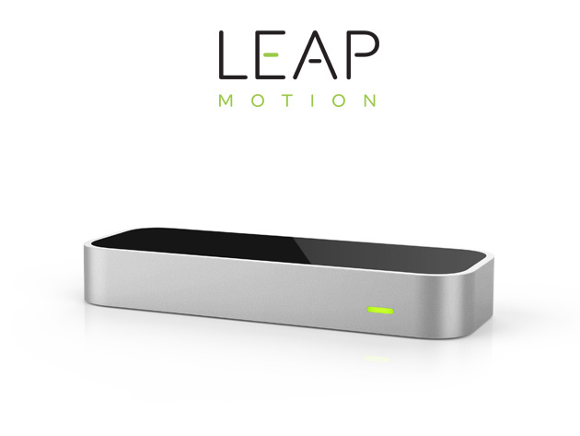
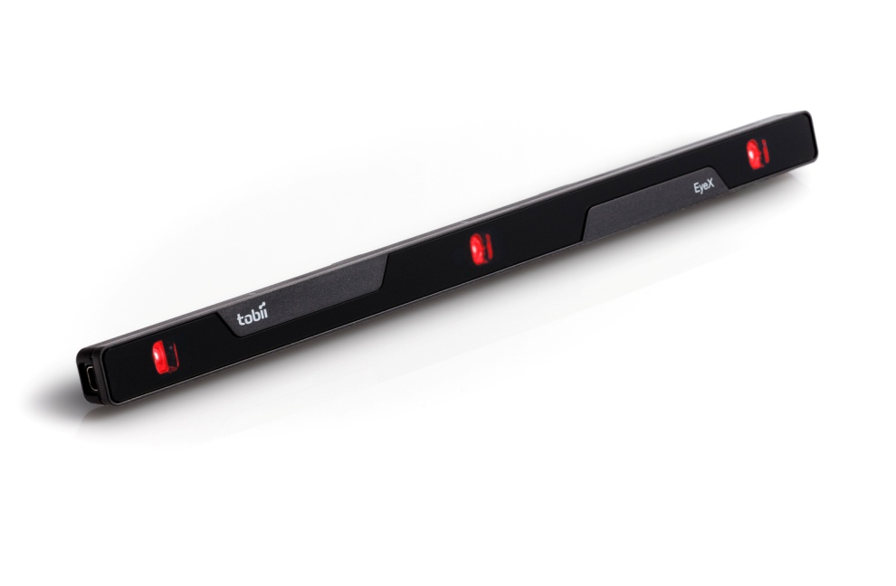
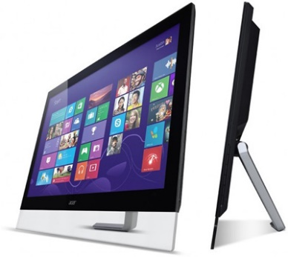
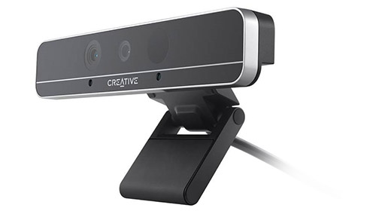
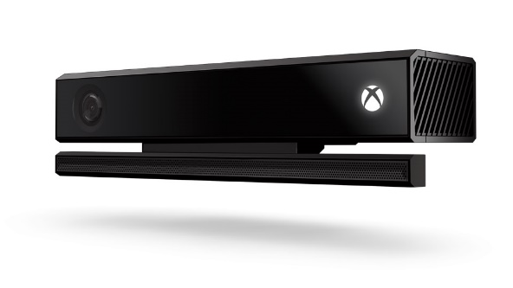
Devices
Leap Motion Sense
Acer Multi Touch Monitor
Xbox One Kinect
Tobii EyeX
Intel Real Sense Depth Camera

Slide 5
Intel Real Sense Depth Camera
Give feedback to user about which feature is being activated

Slide 6
More Wishes
Tutorial System for devices and features
Gamification

Slide 7
Thanks For Watching

